Slide 1
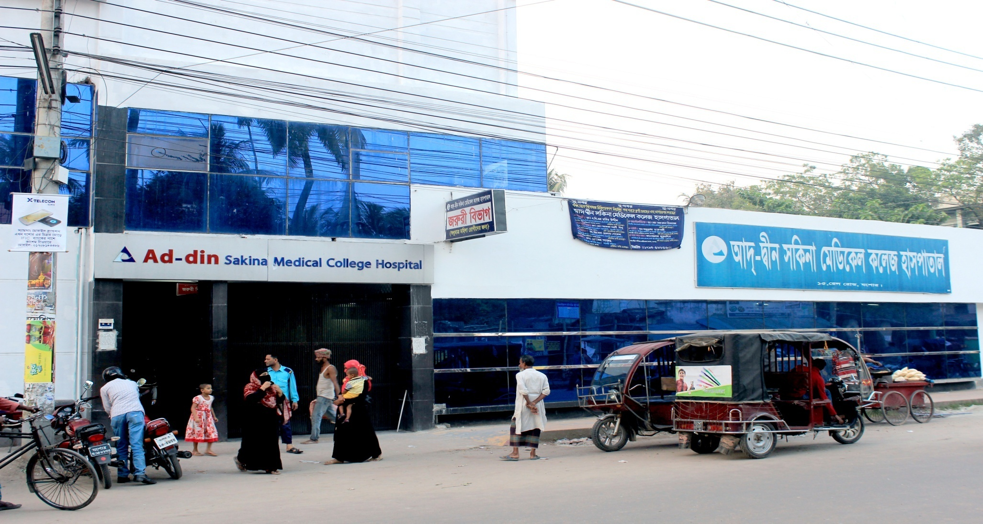
Ad-din Sakina Women’s Medical College Hospital

Slide 2
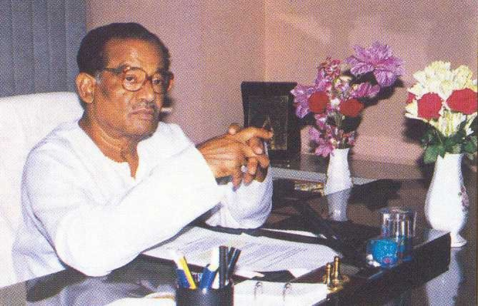
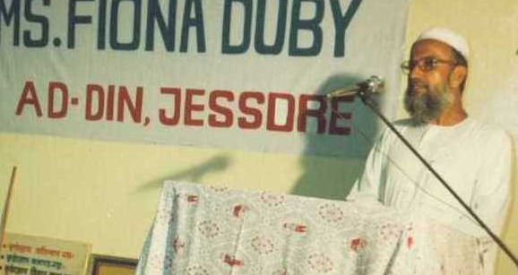

Founder of Ad-din
Late Sheikh Akijuddin
Founder Chairman
Established Ad-din out of corporate social responsibility.
Founder of Akij Group with 20 business units.
Late Prof. Sharif Hossain
Founder of lot of social organizations, educationist, recipient of Ekushe Padak.
Dr. Sheikh Mohiuddin
Founder Executive Director

Slide 3


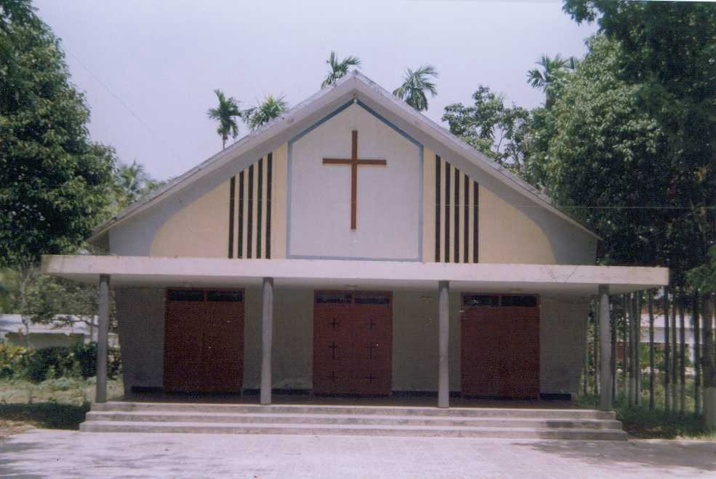
Core Values
To respect and take care of the cultural & religious values of our country as a part of development

Slide 4

Ad-din Sakina Medical College Hospital
Background History
Started as an orphanage at Khuladanga, Jashore in 17 December 1980.
Ad-din Hospital Started in 5 April 1985 with the aim of providing standard MCH service with minimum cost .
Ad-din Nursing Institute started in 1997.
Ad-din Medical Technologist institute started in 2004.
Ad-din Sakina Women’s Medical College started in 2011

Slide 5




Ad-din Hospitals
Ad-din Medical College Hospital, Dhaka
Estd. 1 Nov 1997
500-Bed
Ad-din Sakina Medical College Hospital, Jessore
Estd. 4 April 1985
300-Bed
Ad-din Akij Medical College Hospital, Khulna
Estd. 8 Feb 2013
500-Bed:.
Bashundhara Ad-din Medical College Hospital, Keraniganj, Dhaka
Estd. 25 Feb 2012
300-Bed.
Ad-din Hospital, Kushtia
Estd. 1 Nov 1999; 100-Bed
Ad-din Barrister Rofique-Ul Huq Hospital, Postogola, Dhaka
Estd. May 2017; 300-Bed

Slide 6



Nursing Institutes
Ad-din Nursing Institute, Jessore
Estd. Aug 1997
Fatema Nursing Institute, Dhaka Estd. Jul 2006
Safina Nursing Institute, Kushtia Estd. Sept 2005

Slide 7
Academic activities Under graduate level
Intern’s Doctor’s Training : Morning Session, Case Presentation, Monthly Meeting , Discursion on referred case, Teaching according to log book.
5th year MBBS Class
4th year MBBS Class
3rd year MBBS Class
Nursing Training
Ongoing Research study :
  Wound infection
  PROM
  IUD

Slide 8
Organogram of Gyne&Obs Department 0f
Ad-din Sakina Medical College Hospital
Professor | Associate Professor | Assistant Professor
Professor Dr. Badrunnesa Begum | Dr. Nasreen | Dr. Saleha Khatun
Professor Dr. Hasanuzzaman | Dr .Emdadul Haque
Professor Dr. Rabiul Islam
Professor Dr. Torun Khanti Ghosh
Professor Dr. Nikunjo Bihari Goldar
Professor Dr. Gour Kishor
RS | Registrar | Assistant Registrar
Dr. Shila Podder | Dr. Kumruzzaman | Dr. Tonni Moni Chonda
Medical Officer
Dr. Sumayya Sharmin
Dr. Tahmina Shirmin
Dr. Sultana Zaman

Slide 9
Annual Trend of ANC Services

Slide 10
Comparison between NVD and C-Section

Slide 11
Types of obst patients admitted in Obs ward (Jan-Nov) 2021
Title | Number
Pregnancy with Previous C/S | 580
Pregnancy with Lower abdominal pain | 581
Pregnancy with Less fetal movement | 454
Pregnancy with PROM | 330
Pregnancy with UTI | 424
Pregnancy with Ante partam haemorrhage | 157
Pregnancy with Anemia | 943
Post Dated Pregnancy | 58
PIH | 349
True labour pain | 632
Hyper Emesis graviderum | 208
Pregnancy with Oligohydramnios | 512
Pregnancy with PUO | 87
IUD | 14
Pregnancy with Big baby | 58
Pregnancy with Breach | 34

Slide 12
Gynae operation list(Jan-Nov-2021)
Total abdominal hysterectomy | 30
Sub total abdominal hysterectomy | 2
Vaginal hysterectomy | 3
Laparotomy | 13
Ovarian cystectomy | 6
Perineal tear | 27
DE&C | 329
Biopsy | 2
Bartholin cyst | 2
Total = | 414

Slide 13
Performance of gynae and obst Department from 2010-2021(Jan-Nov)
Year | Total IPD Patients | Total OPD Patients | Gynae Patients | ANC | PNC | FP | C/S | Delivery | Total Delivery | DE&C | Gynae OT
2010 | 4208 | 46244 | 7802 | 28161 | 6765 | 3516 | 2715 | 577 | 3292 | 91 | 21
2015 | 5607 | 44070 | 8105 | 25249 | 6460 | 3860 | 2879 | 606 | 3485 | 198 | 40
2018 | 7458 | 44472 | 9779 | 25325 | 5992 | 3376 | 3446 | 616 | 4062 | 446 | 88
2019 | 7757 | 43108 | 9362 | 24117 | 6217 | 3412 | 3336 | 826 | 4162 | 326 | 67
2020 | 6495 | 37434 | 6749 | 21673 | 5697 | 3315 | 3213 | 654 | 3867 | 298 | 64
2021 (Jan-Nov) | 5375 | 31797 | 7180 | 15641 | 5534 | 3442 | 2621 | 430 | 3051 | 329 | 65

Slide 14
Gynae operation list(Jan-Nov-2021)
Total abdominal hysterectomy | 30
Sub total abdominal hysterectomy | 2
Vaginal hysterectomy | 3
Laparotomy | 13
Ovarian cystectomy | 6
Perineal tear | 27
Biopsy | 2
Bartholin cyst | 2
Total = | 85

Slide 15
Family planning sector report
Title
OCP | 1960
Condom | 5300
DMPA | 288
Cupper - T | 1
Ligation | 53

Slide 16
Best Performing EmOC MC Hospital in Khulna Division -2020
C-Section, NVD, Total Delivery

Slide 17
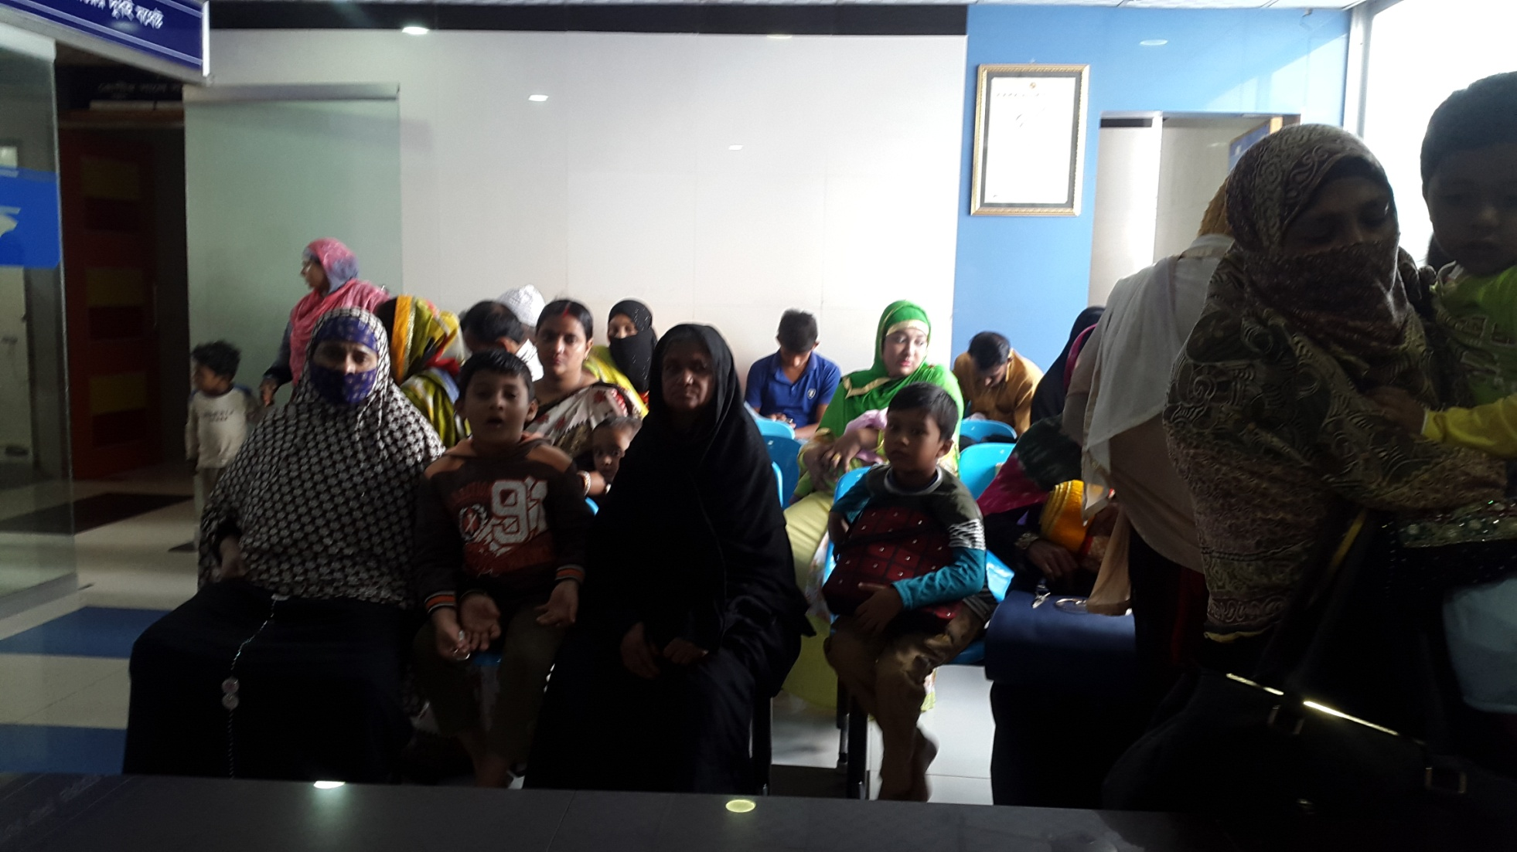
Ad-din Sakina Medical College Hospital Outdoor

Slide 18
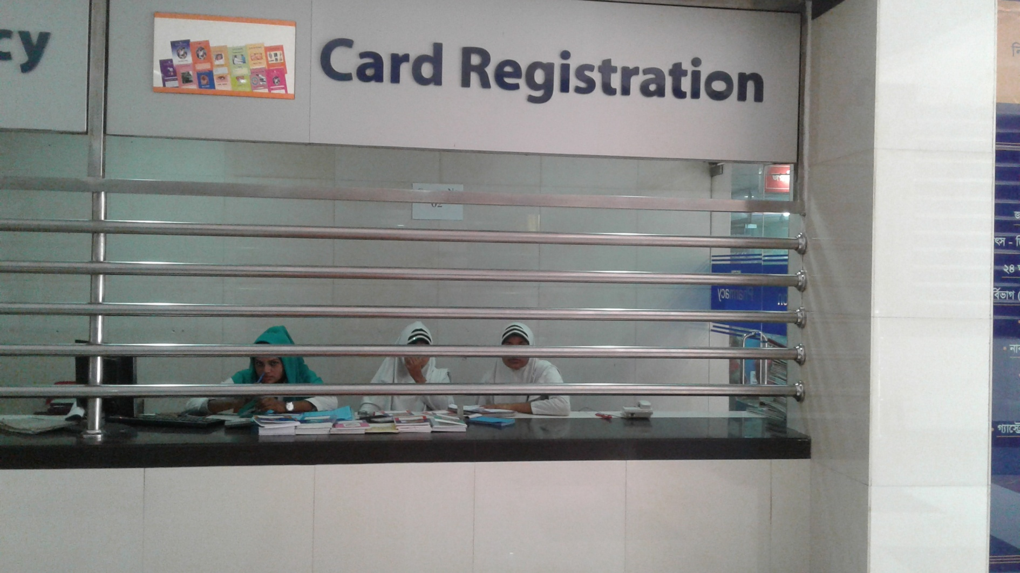
Card Registration

Slide 19
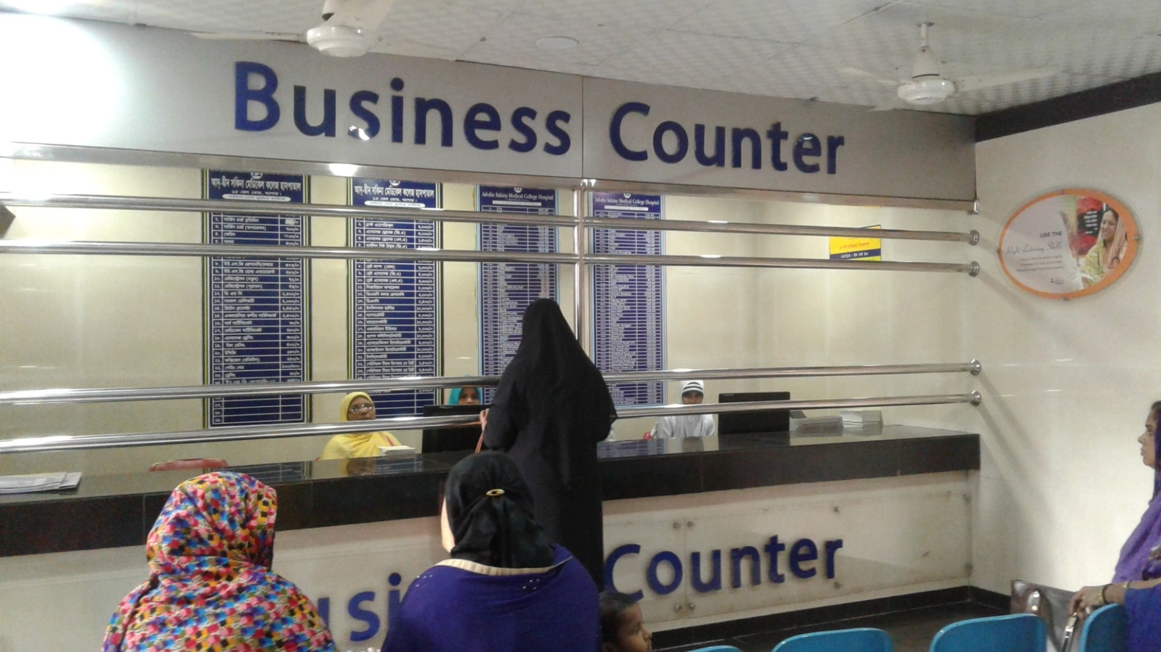
Business Counter

Slide 20
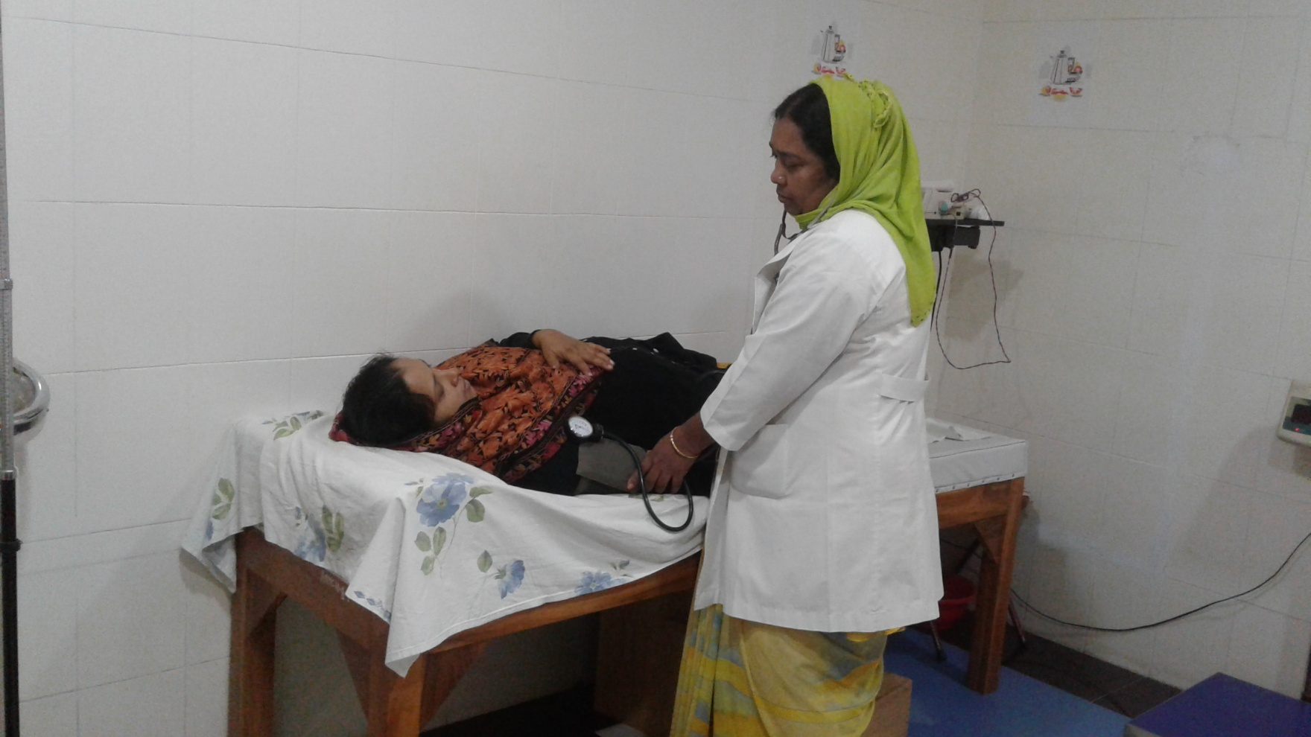
Antenatal Care

Slide 21
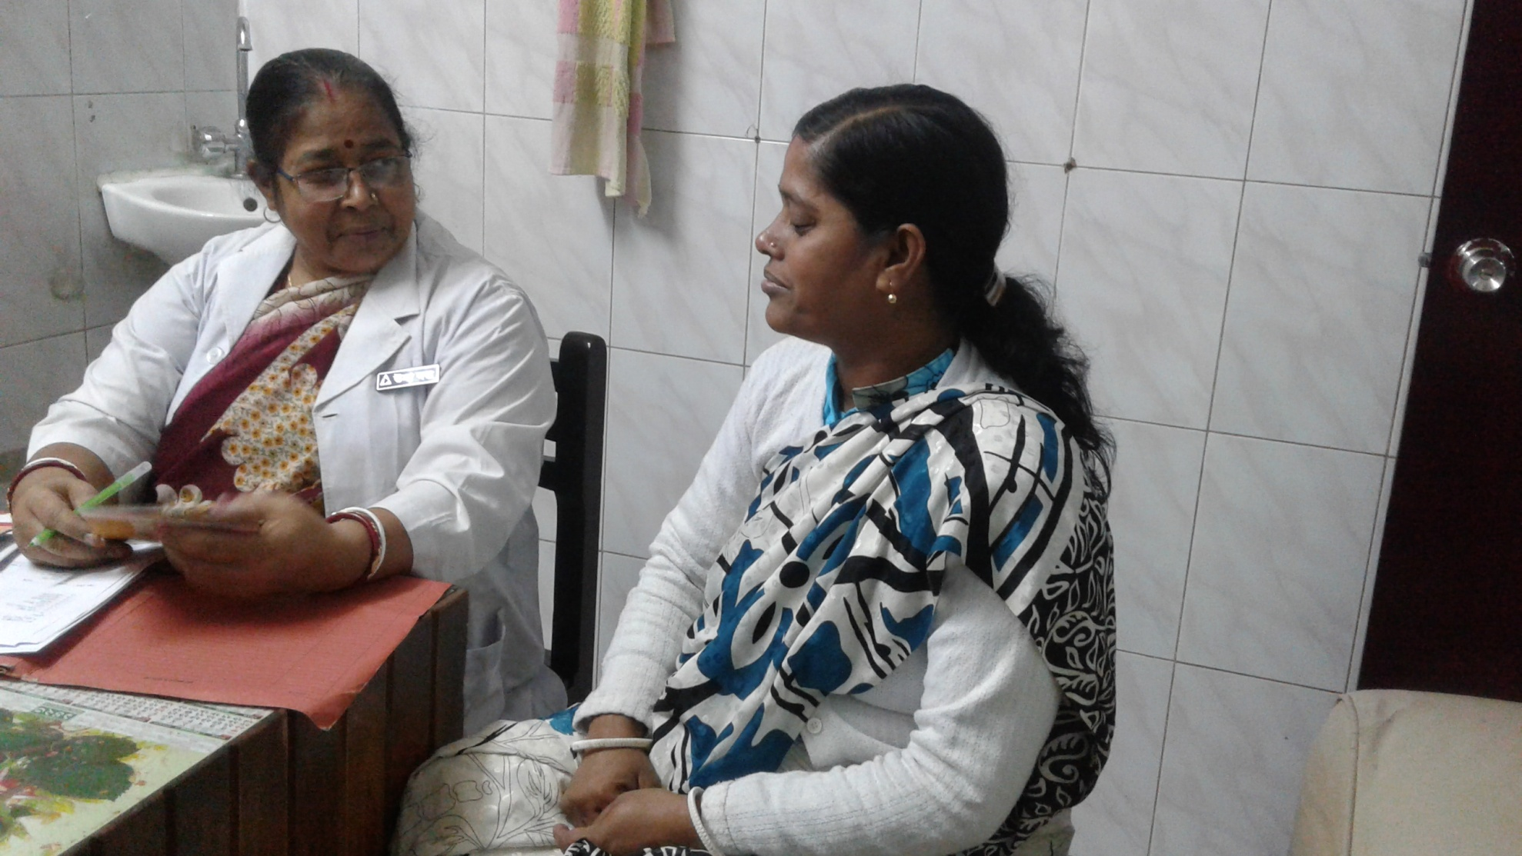
Family Planning

Slide 22
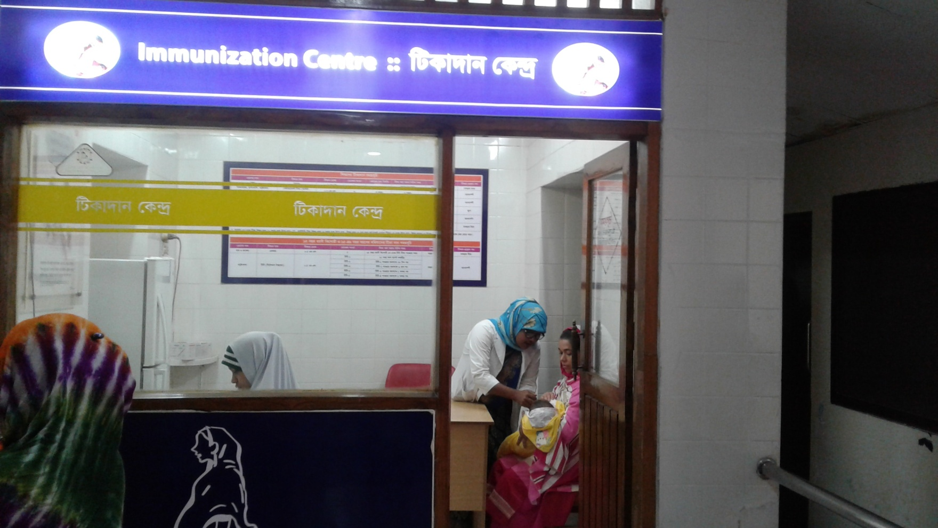
Immunization

Slide 23
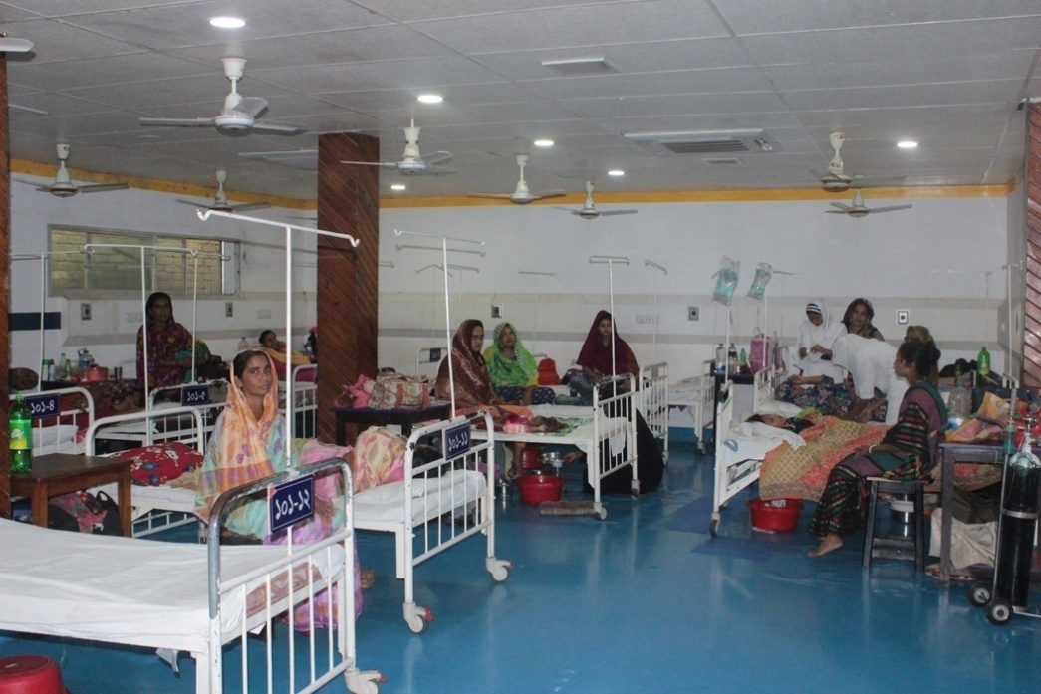
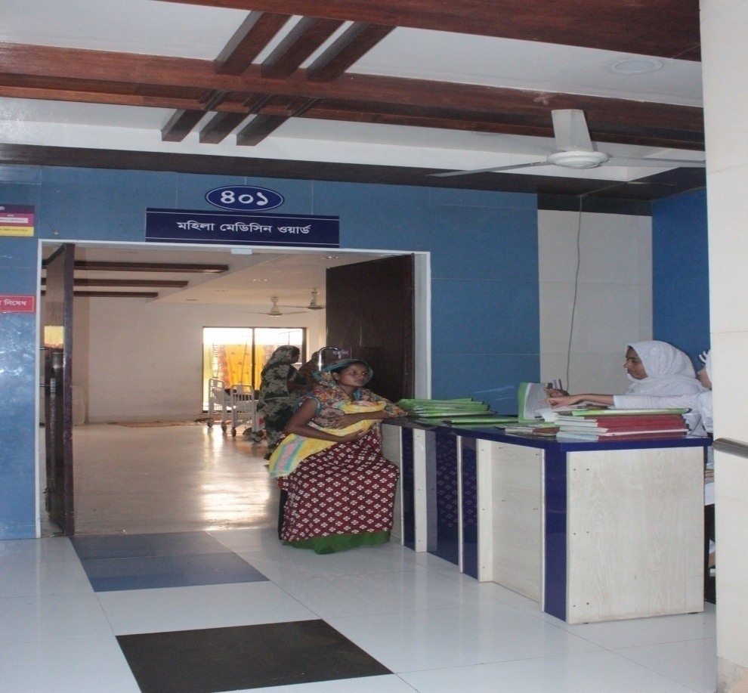
Ad-din Sakina Medical College Hospital Indoor Service

Slide 24
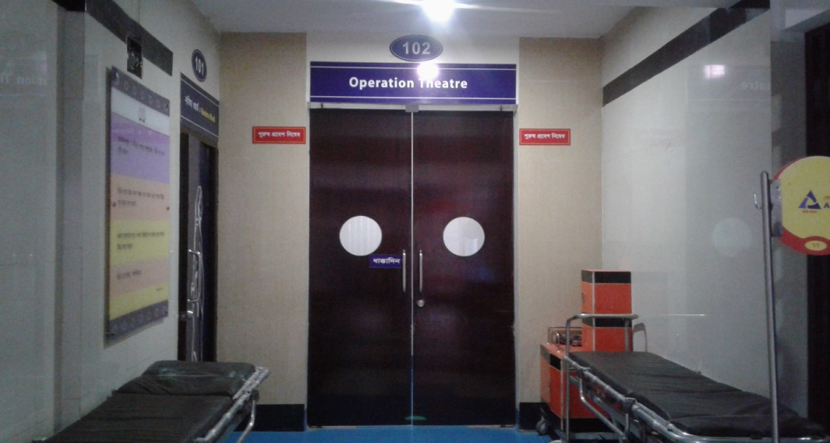
Operation Theatre

Slide 25
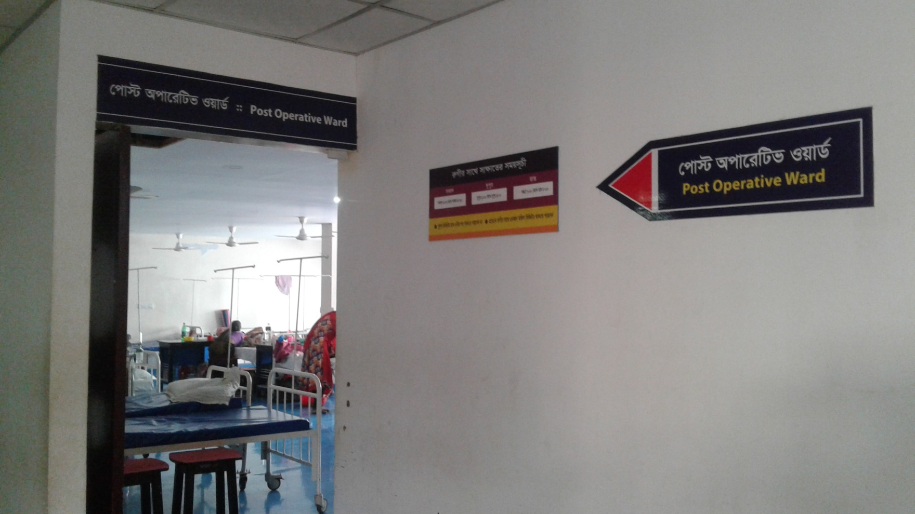
Post Operative Ward

Slide 26
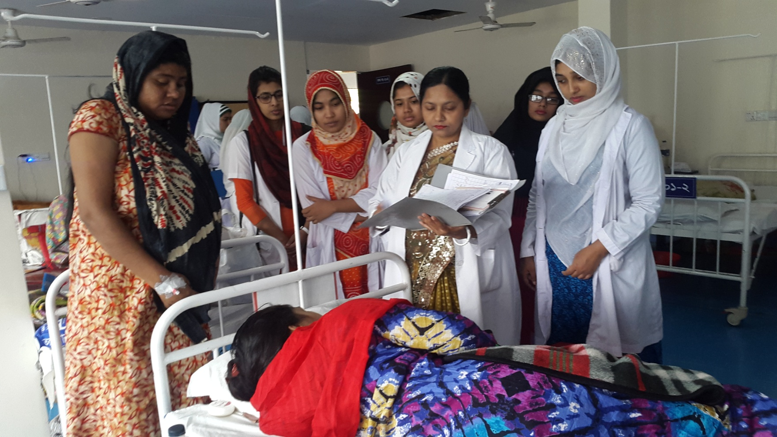
Gyane Ward

Slide 27
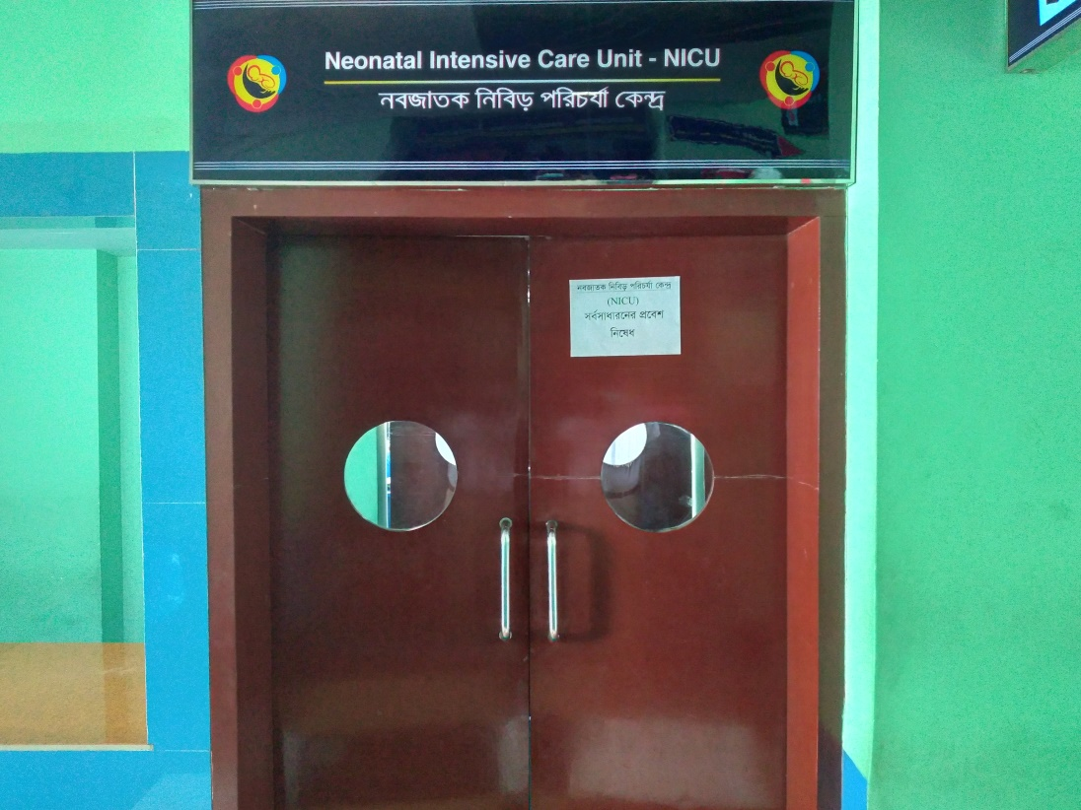
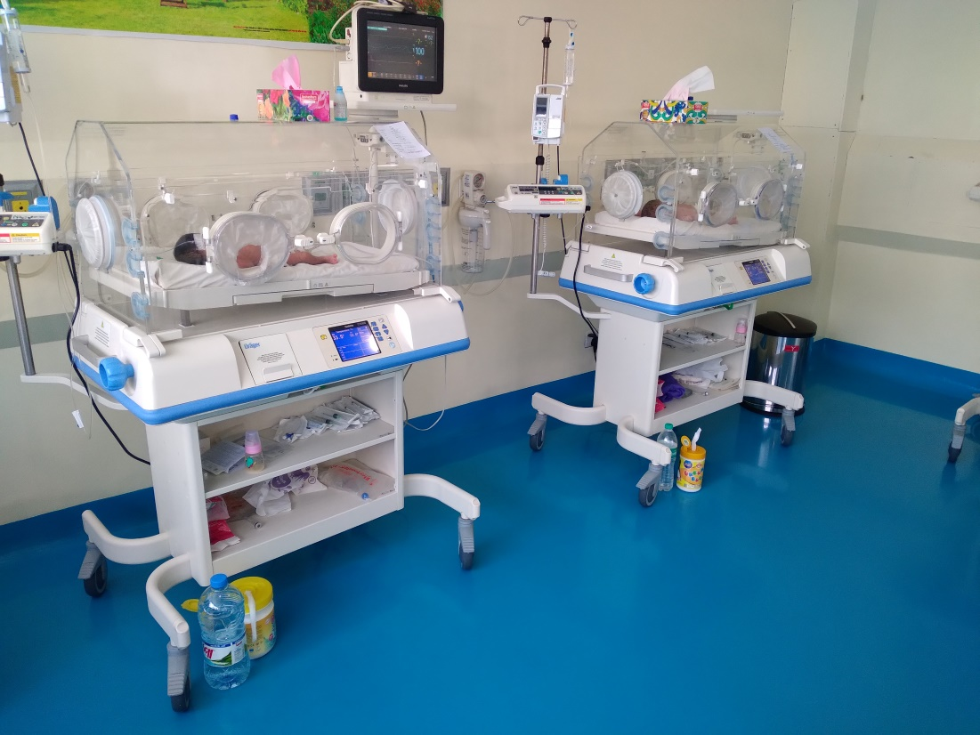
Neonatal Care Unit

Slide 28
VIA Corner

Slide 29
Breast Feeding Corner

Slide 30
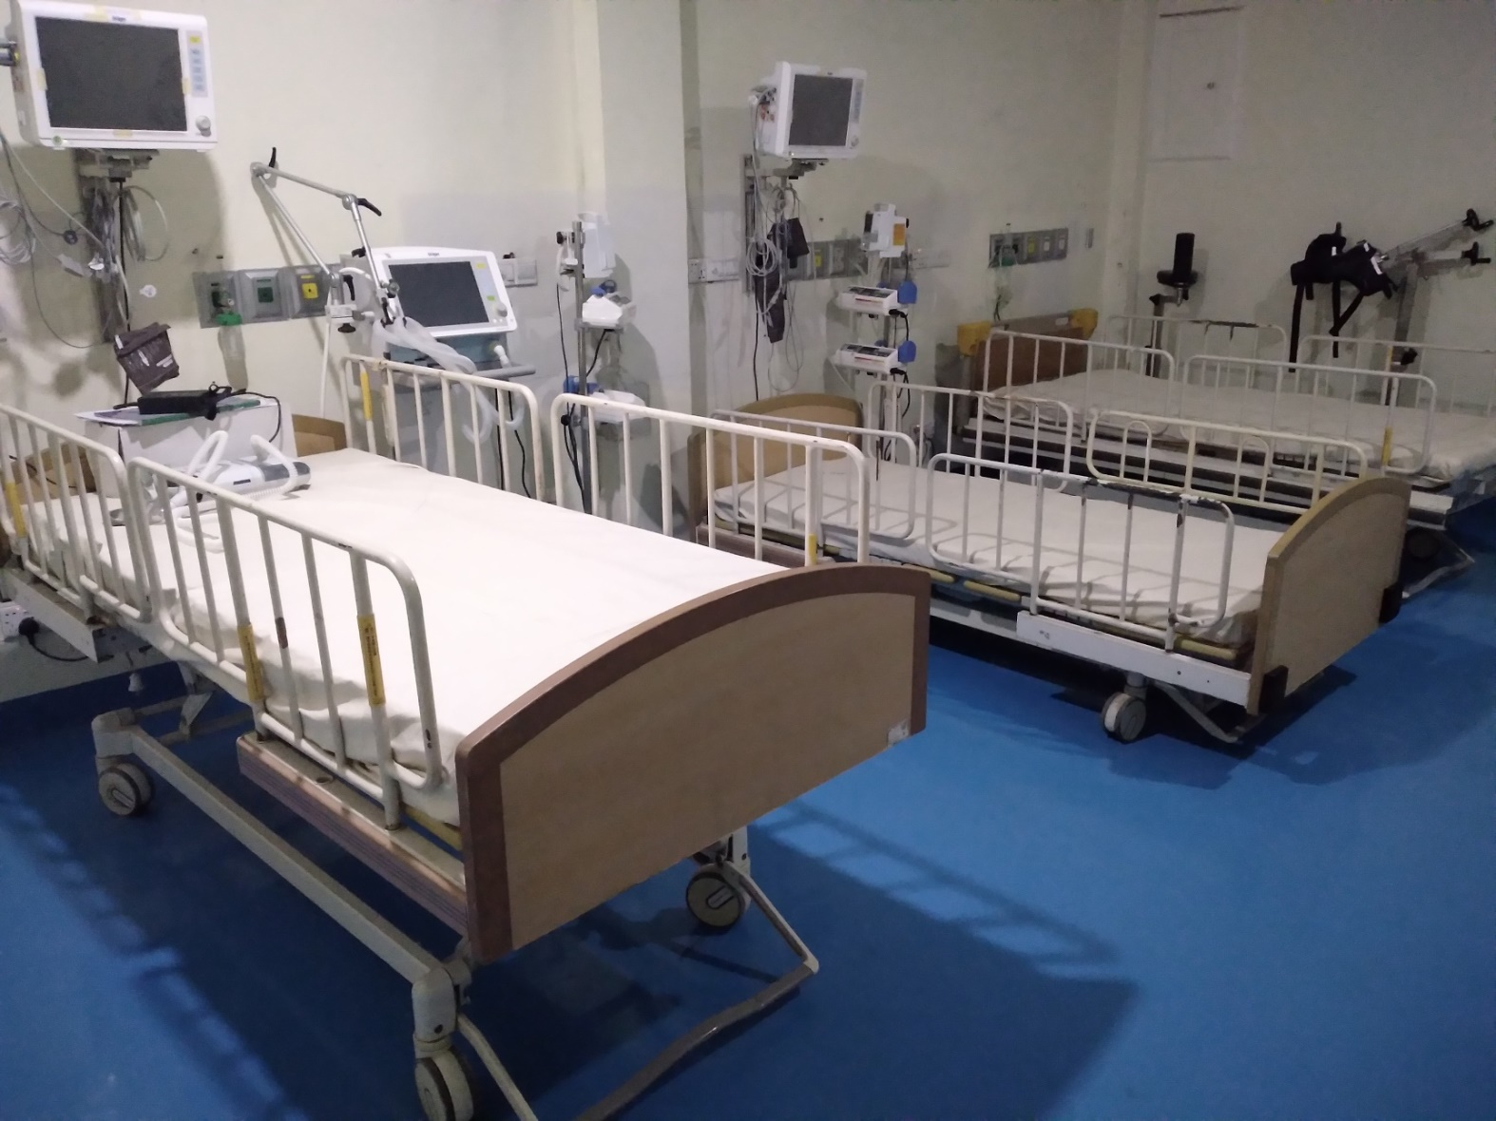
Metrnal ICU

Slide 31
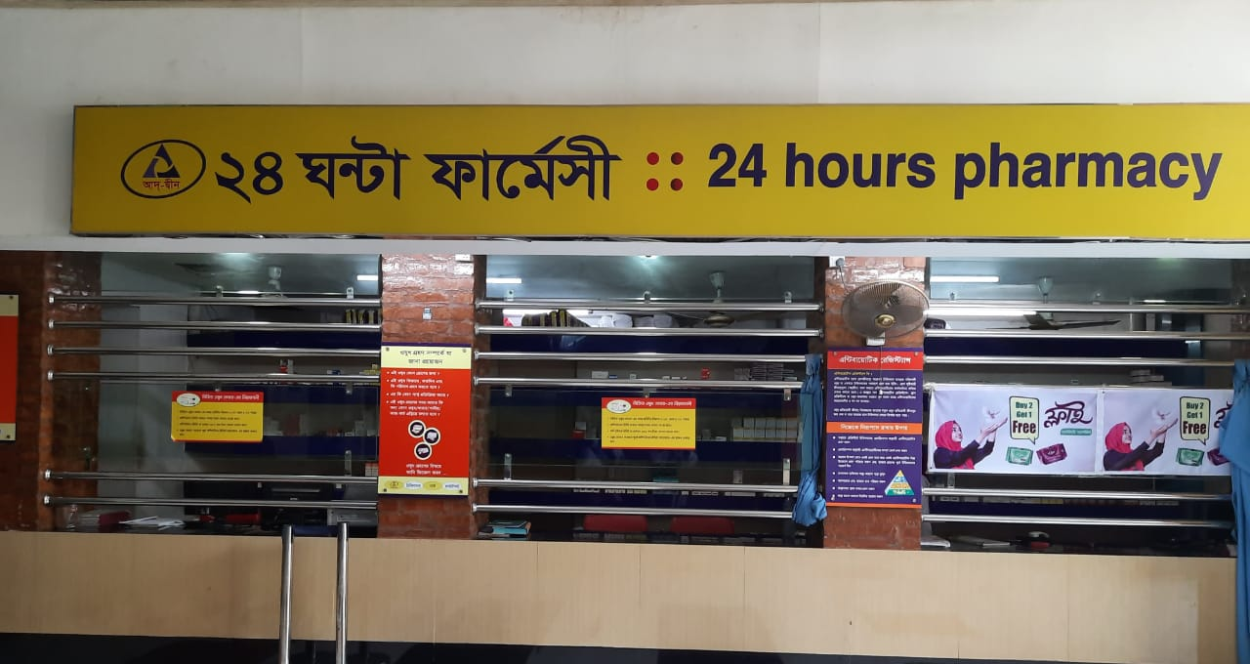
24 Hours Pharmacy

Slide 32
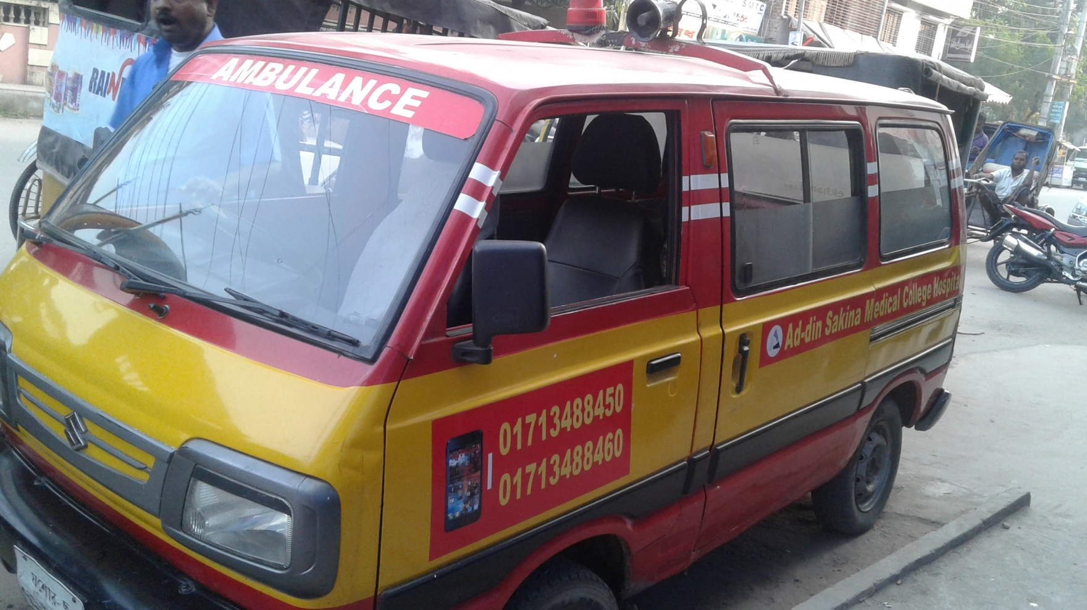
24 Hour Ambulance Service

Slide 33

Community Base Ambulance Service
12 Ambulance are serving in different area in community.
Specialty
Very low cost service (Less than 50% of market Price)
Full free at 8.00pm to 6.00am for Pregnant Mother
Easy & Quick

Slide 34

Community Health Services
Working Area: 14 Districts | Community Midwife | 98
Satellite clinic | 2156

Slide 35

Fistula Care Project
Awareness Development Training
Patient Screening
Treatment 223
Rehabilitation 61
All Services are
free of cost

Slide 36
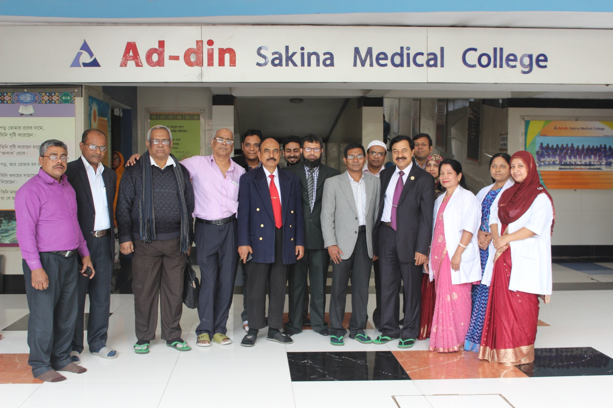
Doctor's & Manager's of Ad-din Sakina Medical College Hospital

Slide 37

Thank You All

